Slide 1

SMART GPS TRACKER USING ARDUINO
REKHA V 19BCE1871

Slide 2

OBJECTIVE
The proposed Arduino based tracking system uses global positioning system and global system using GSM modules. GSM module with a SIM card is used for purposed of communication.
•This system can be installed or hidden in your vehicle. After installing the circuit we can easily track the stolen vehicle using a mobile phone.
•Parents can also use this application to track their children by placing this circuit inside the school/college bag.

Slide 3
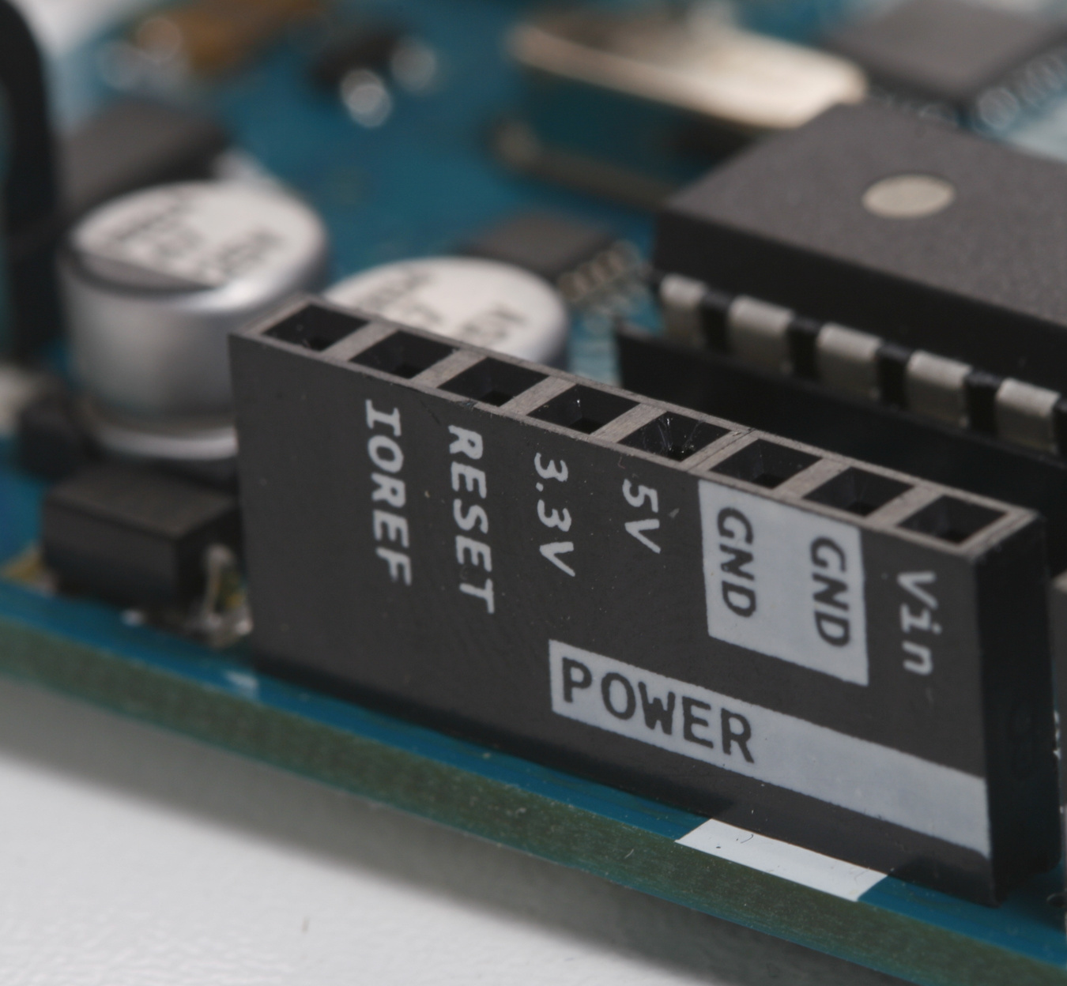
COMPONENTS REQUIRED:
· Arduino Uno
· GPS module
· GSM module
· ESP8266 Wifi-module
· Jumper wires

Slide 4

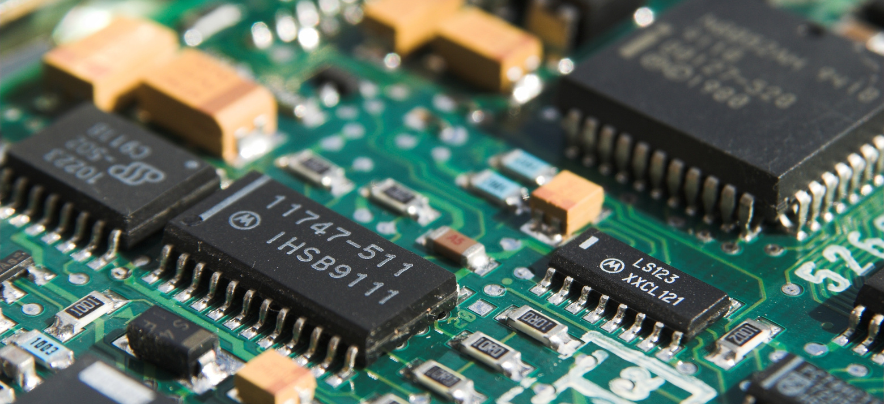
SOFTWARE SIMULATION TOOL
PROTEUS professional
HARDWARE TOOL
Arduino software
and hardware components

Slide 5
BLOCK DIAGRAM:
Cloud :ThingSpeak

Slide 6
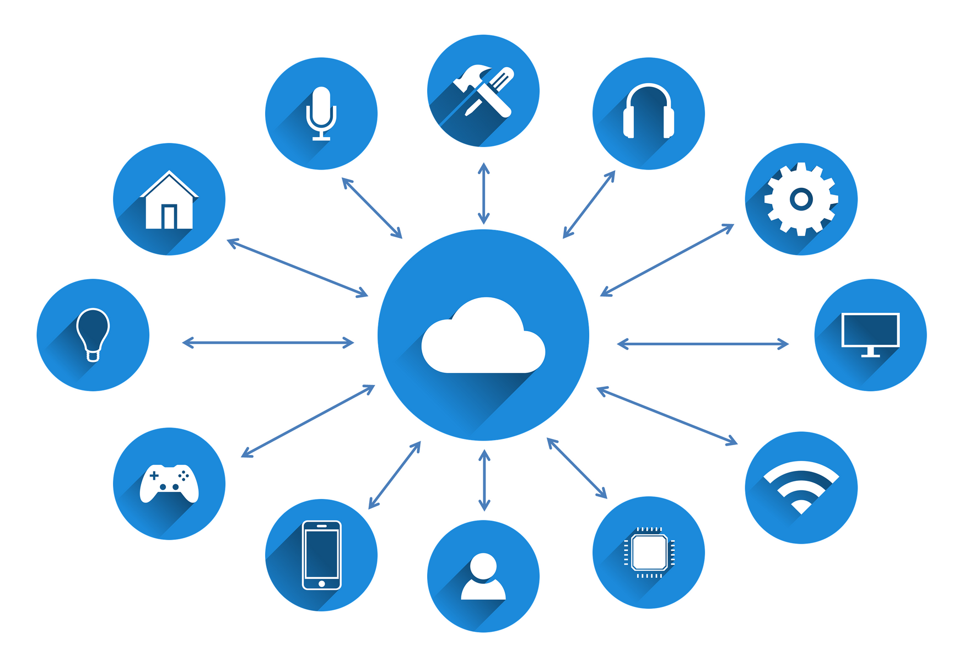
MODULES:
GPS: To get the latitude and longitude.
GSM: To receive messages and for communication.
Arduino: Acts as an interface for GPS and GSM.
LCD: To display the co-ordinates.
Connecting to the cloud i.e ThingSpeak using cellular data of GSM.

Slide 7
CODING:

Slide 8

OUTPUT

Slide 9
THANK YOU
TEAM NAME:FRANCE

